Slide 1



Komaza Data Quality Dashboard
View in Power BI
Last data refresh:
24/09/2024 11:42:35 UTC
Downloaded at:
24/09/2024 14:50:00 UTC

Slide 2
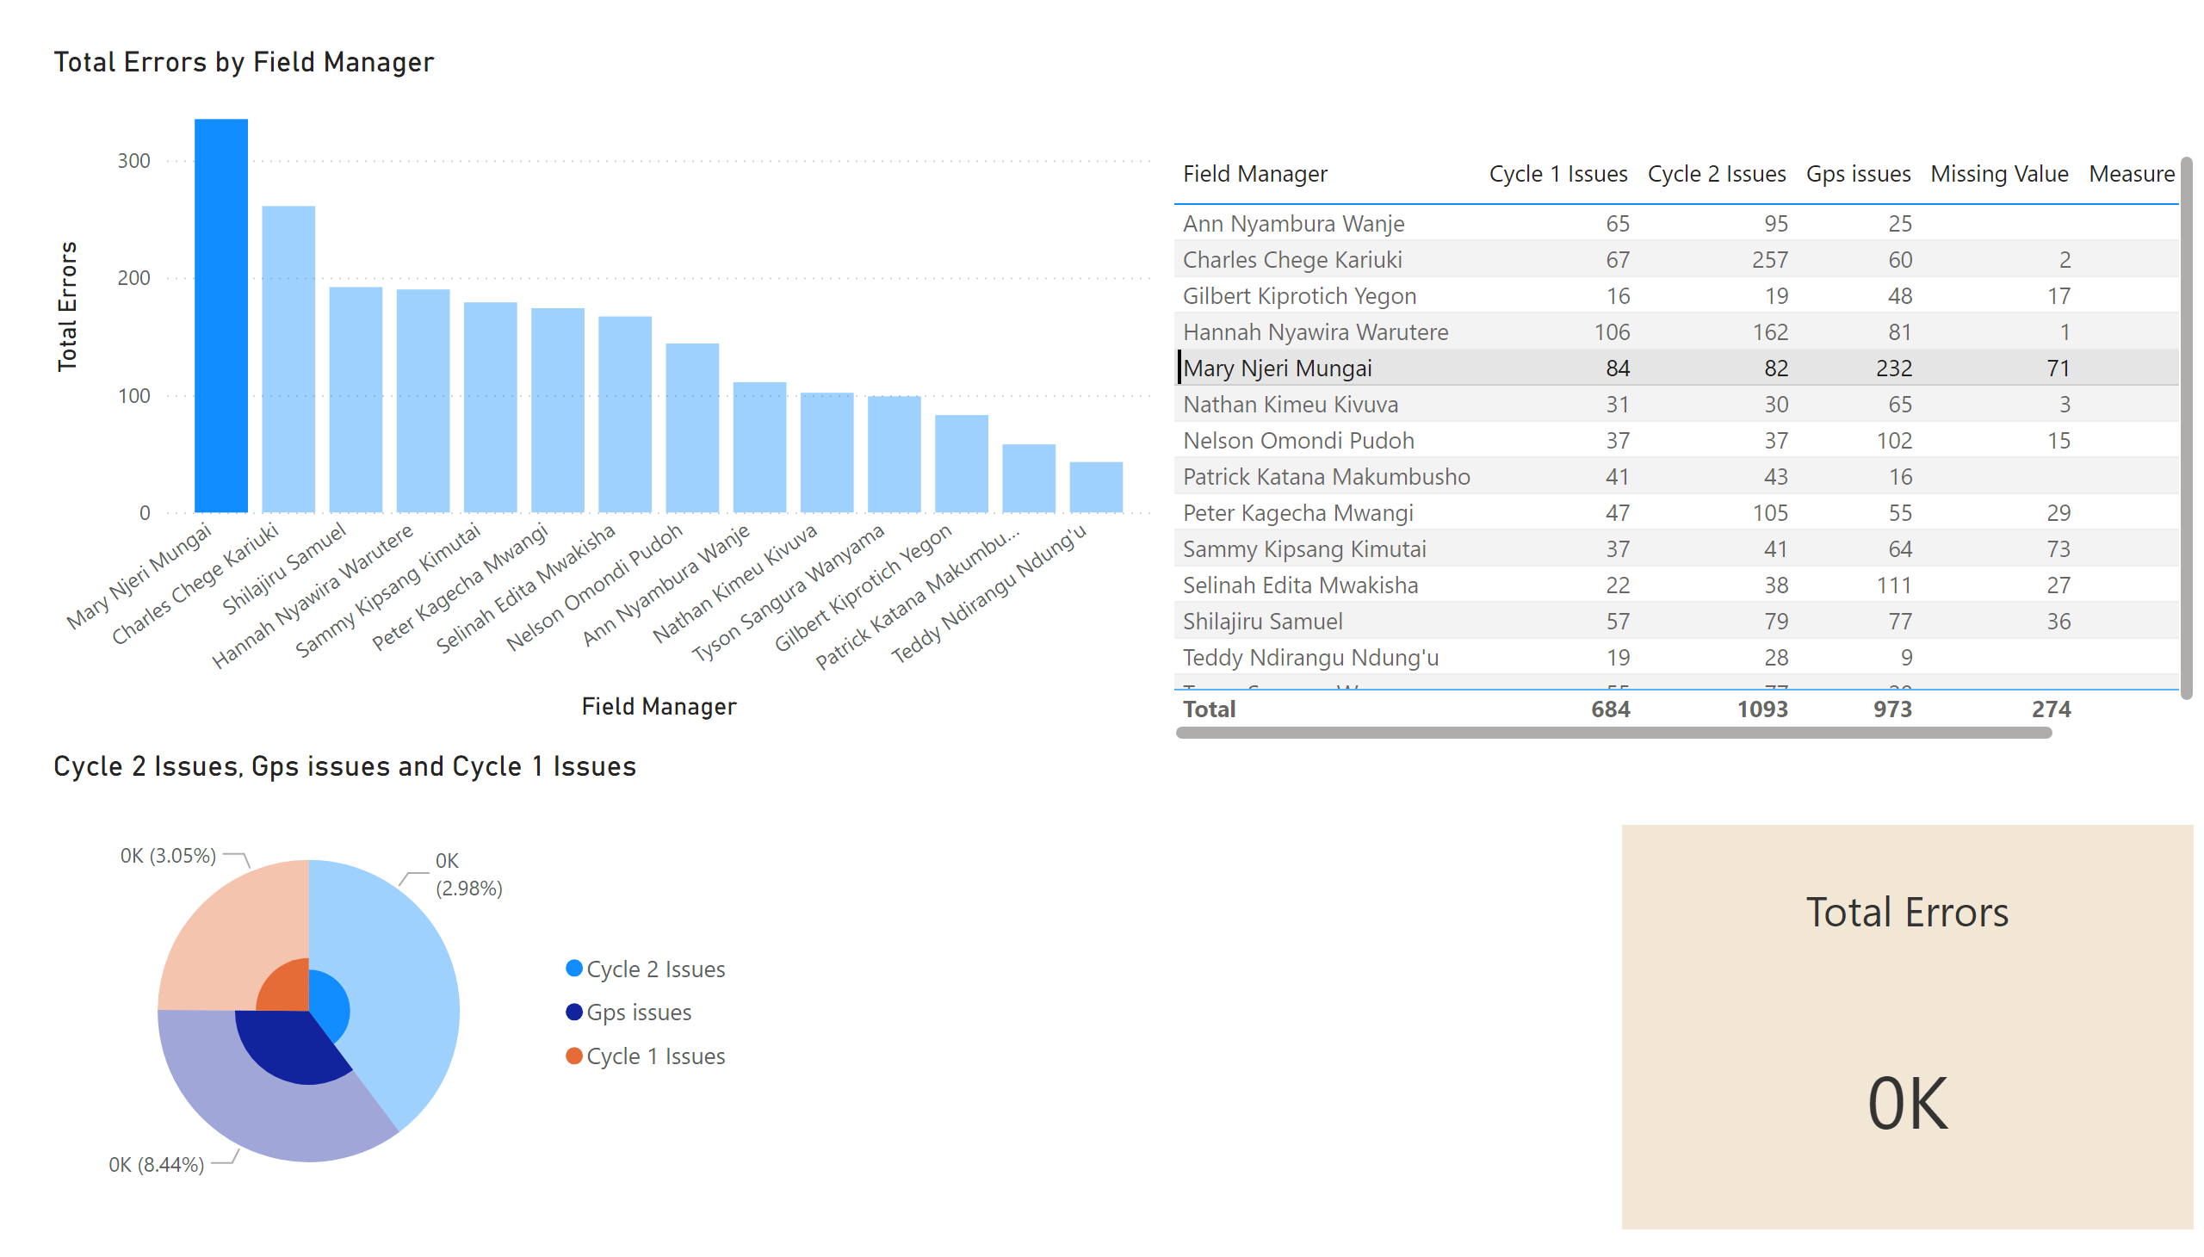
Page 1
Notes:
clusteredColumnChart
No alt text provided
pieChart
No alt text provided
tableEx
No alt text provided
Multi_target_KPI
No alt text provided

